Slide 1
recursions

Slide 2
What is Recursive Function/Method?
A Method can call another methods but it can also call itself. When a method calls itself, it'll be named recursive method. Recursive method calls itself so many times until a certain condition is being satisfied.

Slide 3
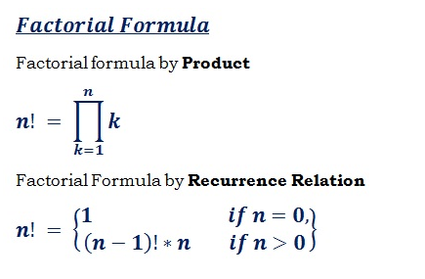
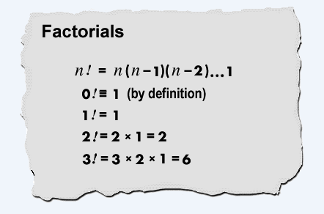
Calculating the factorial of a number
The factorial (!) of a positive integer number is the product of all positive integers less than or equal to the number.

Slide 4
Writing a method that calculates the factorial of a number
First we create a method for the calculation of the factorial and make a static method to invoke the method directly without using the instance of the class with the following code.

Slide 5
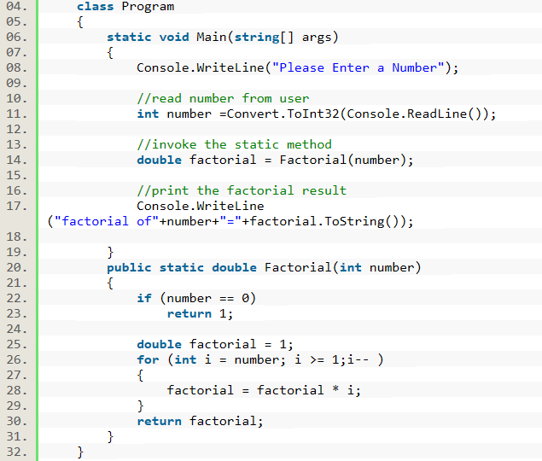
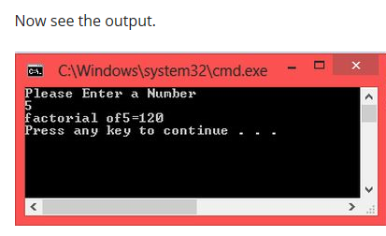

Slide 6
Calculating the factorial of a number by recursion

Slide 8
Program logic
You know, the factorial of n is actually the factorial of (n-1) multiplied by n, if n > 0.
Factorial(n) returns Factorial(n-1) * n
That is the returned value of the method; and before that, we need a condition:
If n = 0 Then Return 1

Slide 9
Sorting algorithms

Slide 10
Sorting algorithms
Sorting algorithms are algorithms that arrange the items in a list in a certain order. For example, you can use a sorting algorithm to sort a list of students in ascending order of their last name.
In the early days of data processing, sorting was an important problem that attracted a lot of research.
These days, you can find basic sorting capabilities already built into most popular libraries and data structures. For example, in the .NET Framework, you can make use of the Array.Sort method to sort an array.
However, it is still important to look at sorting as a way to understand problem solving and algorithm analysis. In this section, you will take a look at two common sorting algorithms, BubbleSort and QuickSort.

Slide 11
Bubble sort

Slide 12
Understanding BubbleSort
BubbleSort works by comparing two elements to check whether they are out of order; if they are, it swaps them.
The algorithm continues to do this until the entire list is in the desired order.
BubbleSort gets its name from the way the algorithm works: As the algorithm progresses, the smaller items are “bubbled” up.

Slide 13
Understanding BubbleSort
Let’s visualize BubbleSort with the help of an example. Say you want to arrange all the items in the following list in ascending order: (20, 30, 10, 40).
These items should be arranged from smallest to largest. The BubbleSort algorithm attempts to solve this problem in one or more passes, with each pass completely scanning the list of items.
If the algorithm encounters out-of-order elements, it swaps them. The algorithm finishes when it scans the whole list without swapping any elements.
If there were no swaps, then none of the elements were out of order and the list has been completely sorted.

Slide 14
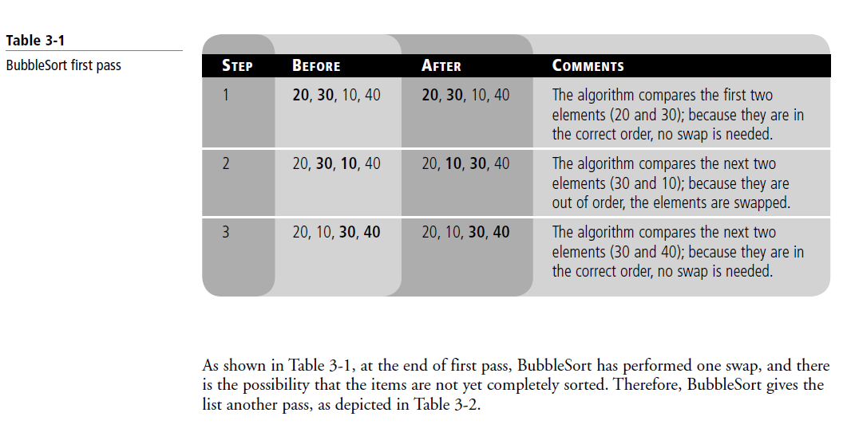

Slide 15
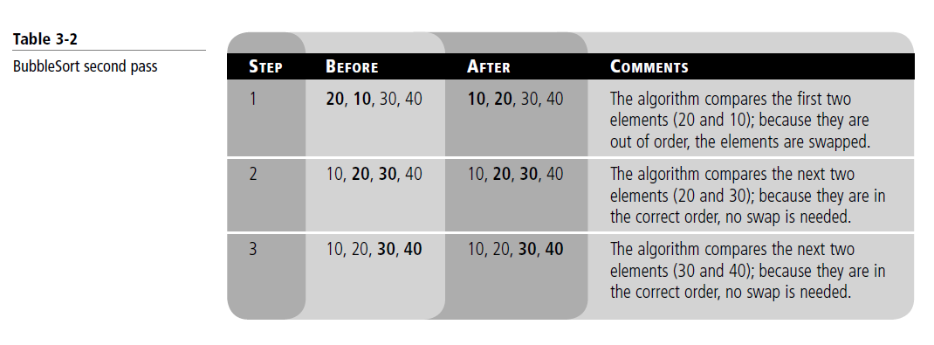

Slide 16
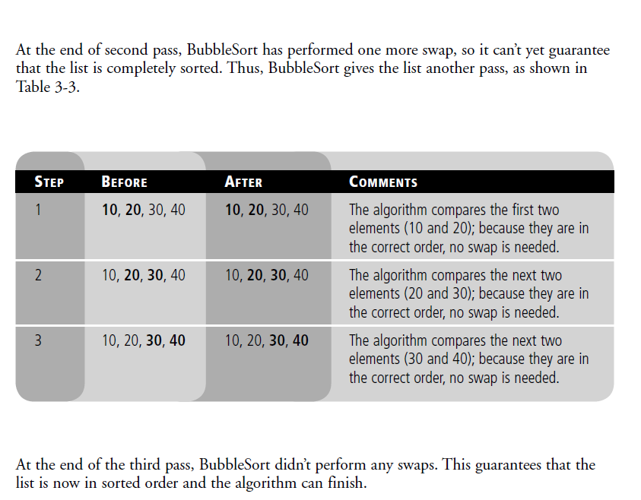

Slide 17
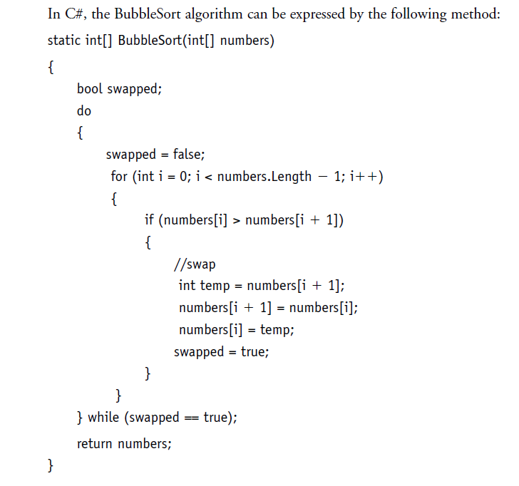

Slide 18
quicksort

Slide 19
Quicksort
QuickSort is a Divide and Conquer algorithm. It picks an element as pivot and partitions the given array around the picked pivot.
First, we’ve to choose an element from the list (called a pivot), then we must put all the elements with value less than the pivot on the left side of the pivot and all the items with value greater than the pivot on its right side. After that, we must repeat these steps for the left and the right sub-lists.

Slide 20
Quicksort
The key process in quickSort is partition(). Target of partitions is, given an array and an element x of array as pivot, put x at its correct position in sorted array and put all smaller elements (smaller than x) before x, and put all greater elements (greater than x) after x.

Slide 21
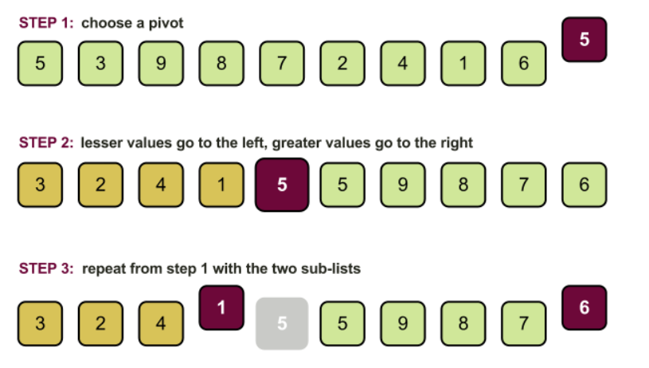

Slide 22
Partition Algorithm
The logic is simple, we start from the leftmost element and keep track of index of smaller (or equal to) elements as i.
While traversing, if we find a smaller element, we swap current element with arr[i]. Otherwise we ignore current element.

Slide 23
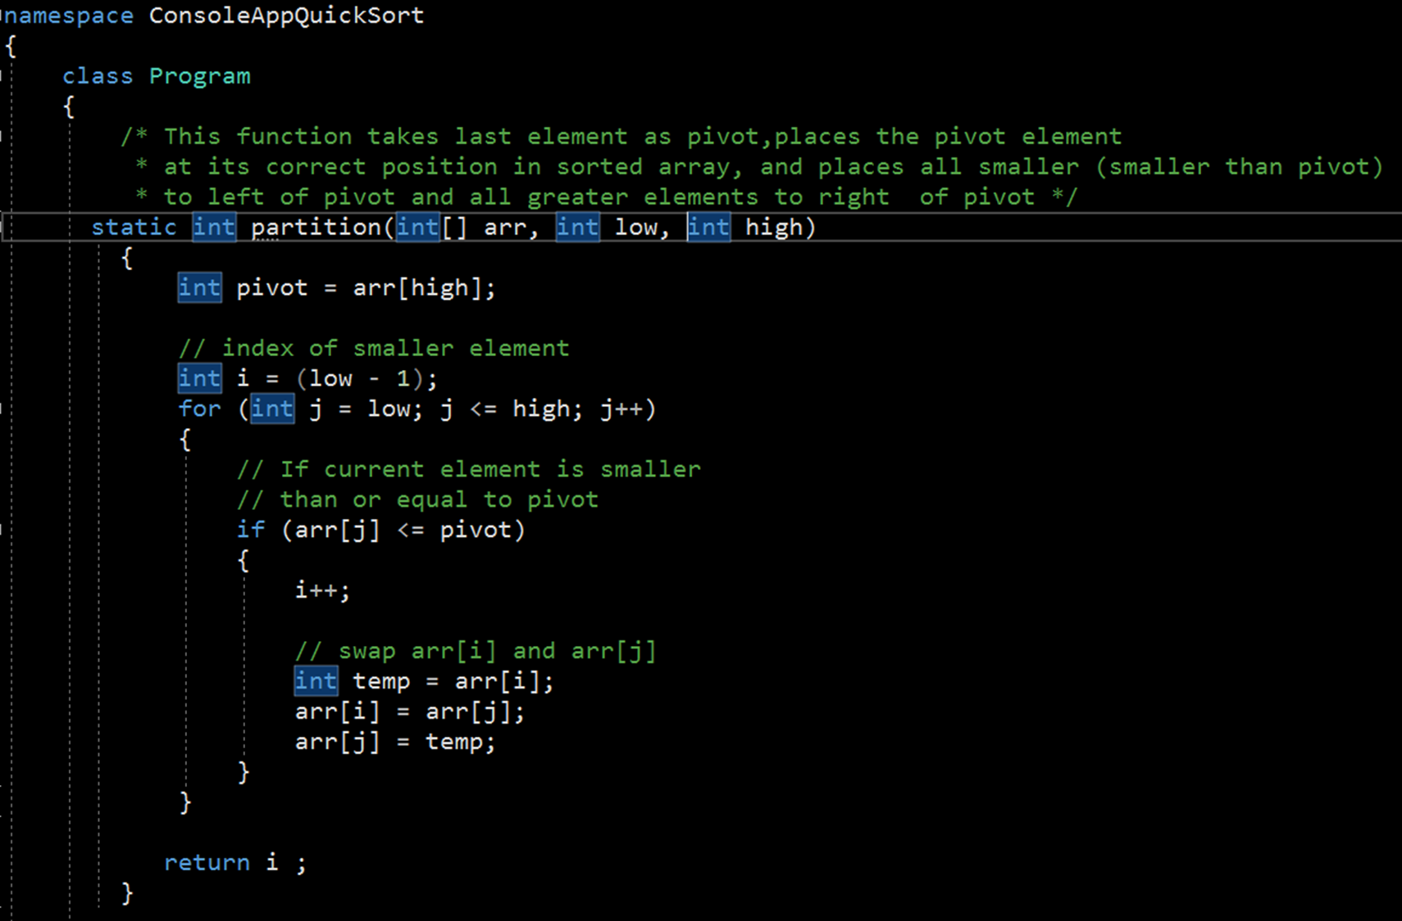
Notes:
namespace ConsoleAppQuickSort
{
class Program
{
/* This function takes last element as pivot,
places the pivot element at its correct
position in sorted array, and places all
smaller (smaller than pivot) to left of
pivot and all greater elements to right
of pivot */
static int partition(int[] arr, int low,
int high)
{
int pivot = arr[high];
// index of smaller element
int i = (low - 1);
for (int j = low; j < high; j++)
{
// If current element is smaller
// than or equal to pivot
if (arr[j] <= pivot)
{
i++;
// swap arr[i] and arr[j]
int temp = arr[i];
arr[i] = arr[j];
arr[j] = temp;
}
}
// swap arr[i+1] and arr[high] (or pivot)
int temp1 = arr[i + 1];
arr[i + 1] = arr[high];
arr[high] = temp1;
return i + 1;
}
/* The main function that implements QuickSort()
arr[] --> Array to be sorted,
low --> Starting index,
high --> Ending index */
static void quickSort(int[] arr, int low, int high)
{
if (low < high)
{
/* pi is partitioning index, arr[pi] is
now at right place */
int pi = partition(arr, low, high);
// Recursively sort elements before
// partition and after partition
quickSort(arr, low, pi - 1);
quickSort(arr, pi + 1, high);
}
}
// A utility function to print array of size n
static void printArray(int[] arr, int n)
{
for (int i = 0; i < n; ++i)
Console.Write(arr[i] + " ");
Console.WriteLine();
}
// Driver program
public static void Main()
{
int[] arr = { 10, 7, 8, 9, 1, 5 };
int n = arr.Length;
quickSort(arr, 0, n - 1);
Console.WriteLine("sorted array ");
printArray(arr, n);
Console.ReadKey();
}
}
}

Slide 24
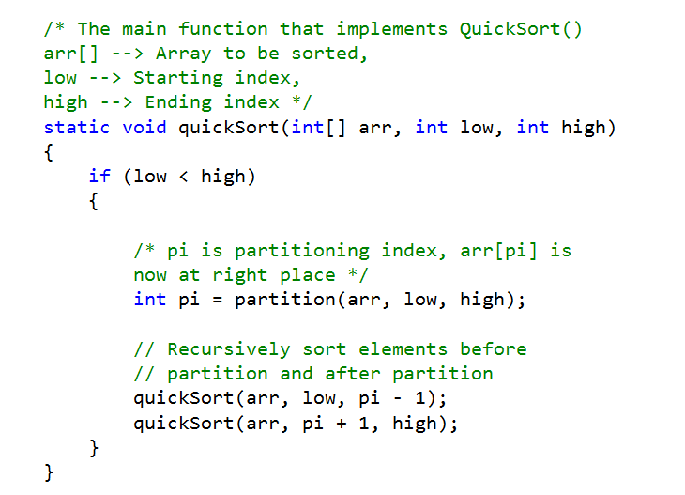

Slide 25
